Slide 1
LEAD SCORING CASE STUDY
MEENAKSHI.S, SHITAL PRASHANT JADHAV, RAHUL JALODHAR PATRA

Slide 2
PROBLEM STATEMENT
X Education sells online courses to industry professionals.
X Education gets a lot of leads, its lead conversion rate is very poor. For example, if, say, they acquire 100 leads in a day, only about 30 of them are converted.
To make this process more efficient, the company wishes to identify the most potential leads, also known as ‘Hot Leads’.
If they successfully identify this set of leads ,the lead conversion rate should go up as the sales team will now be focusing more on communicating with the potential leads rather than making calls to everyone.

Slide 3
BUSINESS OBJECTIVES
Create a Logistic Regression model to predict the Lead Conversion probabilities.
Decide on a probability threshold value above which a lead will be predicted as converted, where as not converted if it is below it.
Assign a lead score value between 0 and 100 to each of the leads which can be used by the company to target potential leads.

Slide 4
STEPS TO REACH OBJECTIVES
Data Cleaning and preparation
1. Check for Duplicates
2. To convert the "Select" into the NaN
3. Dropping columns with more than 70% null values
4. Handling of Missing Value
5. Categorical variables encoding
EDA
Feature scaling & Dummy variables creation
Model Building & Evaluation
Conclusion & Recommendations

Slide 5
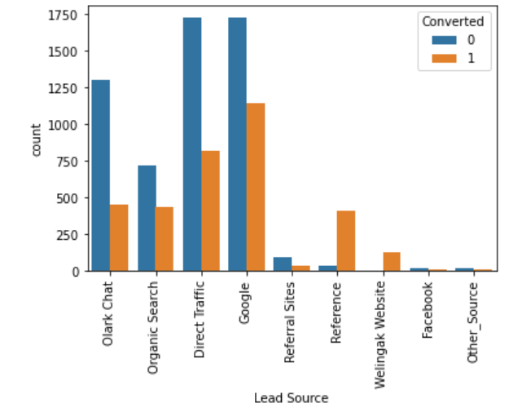
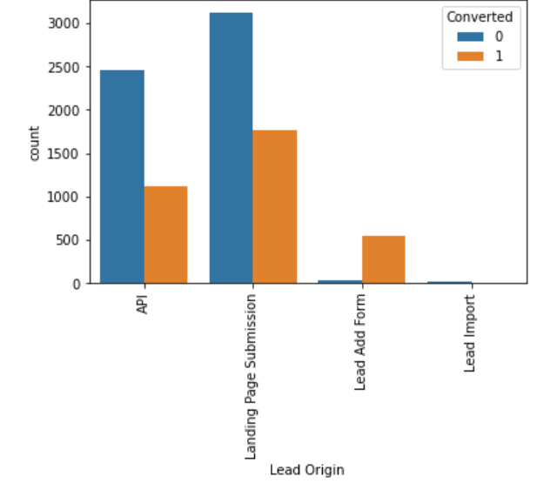
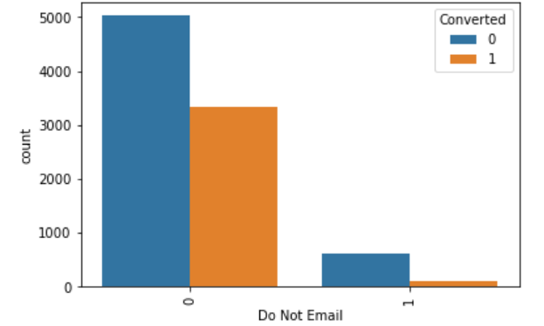
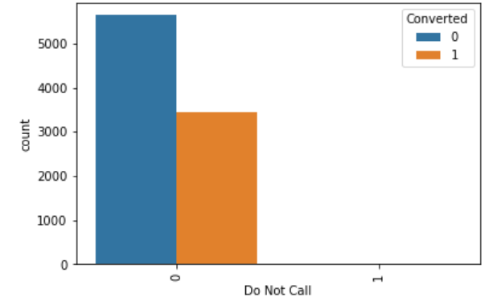
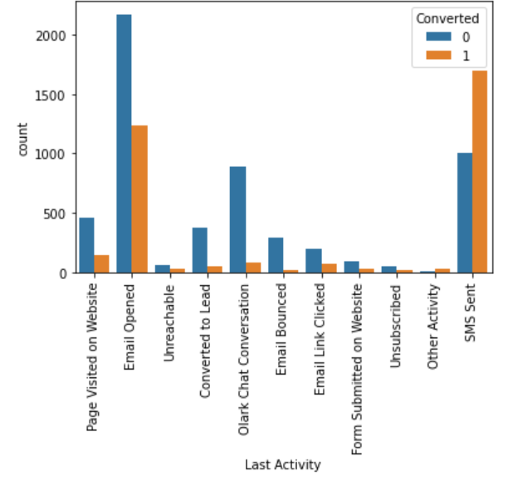
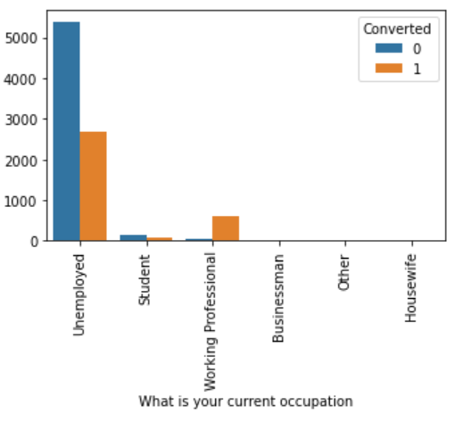
EDA

Slide 6
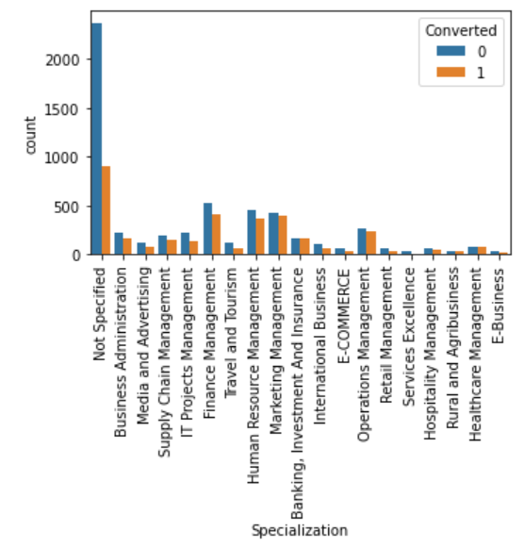
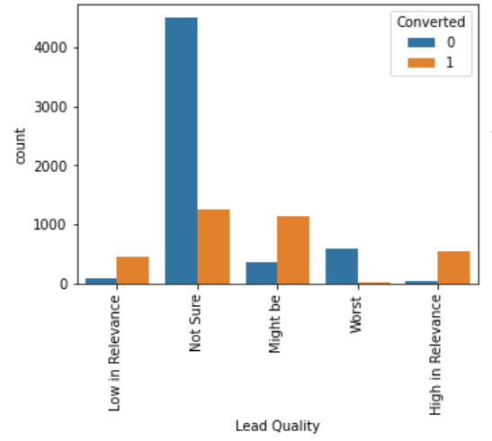
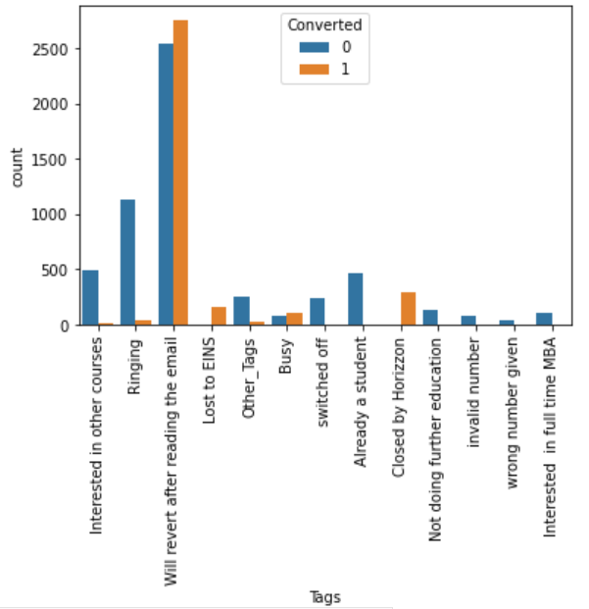
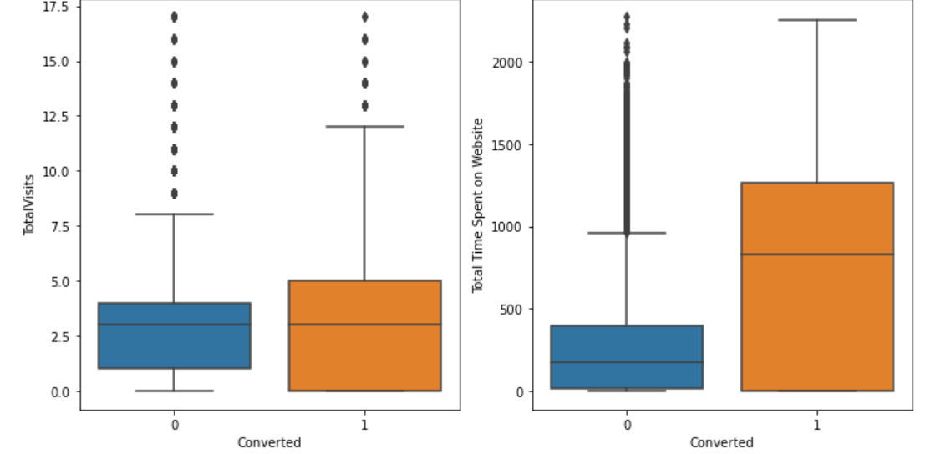

Slide 7
EDA - INFERENCES
Lead Score
Maximum number of leads are generated by Google and Direct traffic.
Conversion Rate of reference leads and leads through welingak website is high
Lead Origin
API and Landing Page Submission has less conversion rate but considerable counts of the leads.
Conversion rate is very high from the Lead Add Form but count of leads is low.
Users spending more time on the website are more likely to get converted.
Last Activity
The conversion rate of "SMS sent" as last activity is maximum.
"Email Opened" activity is having maximum count.
High conversion rate observed in Working professionals.
Tags
'Will revert after reading the email' and 'Closed by Horizon' have high conversion rate.

Slide 8
MODEL BUILDING
Splitting data into train and test set (70:30 ratio)
Use RFE to choose top 20 feature variables for model building
Repeated model building by removing variable whose p-value is more than 0.05 and VIF value greater than 5
Final model is built and with probability threshold value of 0.5, below are evaluation metrics of the model,
Accuracy – 91.9 %
Sensitivity – 87.7%
Specificity – 94.5 %

Slide 9
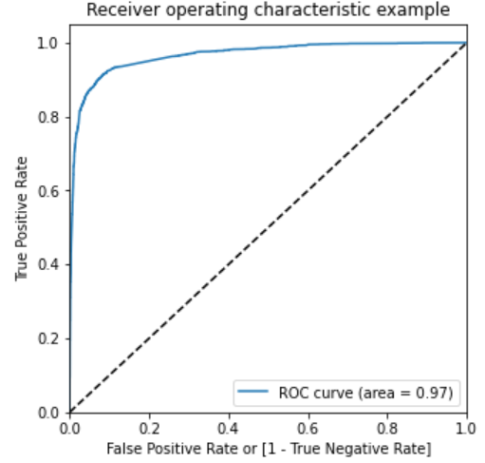
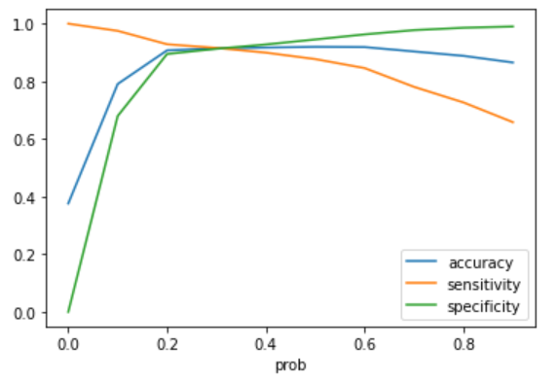
MODEL BUILDING (Cont.)
Balancing all metrics, 0.3 is taken as optimal cut off point
With 0.3 as cut off point, below are evaluation metrics for train & test data set
Average Lead score for converted customers is 90.
 | Train set | Test set
Accuracy | 91.4 % | 90.7 %
Sensitivity | 91.6 % | 92.1 %
Specificity | 91.2 % | 89.9 %

Slide 10
CONCLUSION & RECOMMEDATIONS
Below are variables that impact to positive conversation rate,
Total Visits
Total Time spent on website
Lead origin - Lead Add form
Lead Source
Olark Chat
Welingak website
Current occupation – Working professional
Tags
Closed By Horizon
Busy
Lost to EINS
Will revert after reading email
Last notable activity – SMS sent
With the above information, X Education can improve their sales and increase profit by targeting potential leads.
Higher conversion rate with optimal use of resources can be achieved with different threshold value strategies based on company’s targets.

